Slide 1
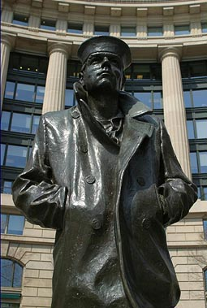
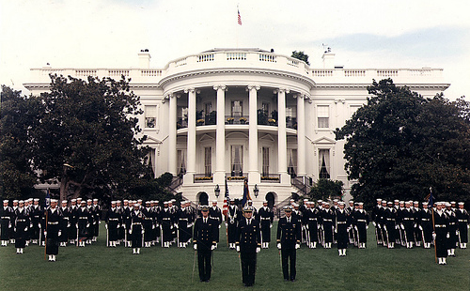
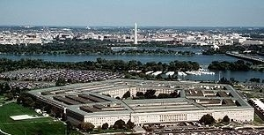
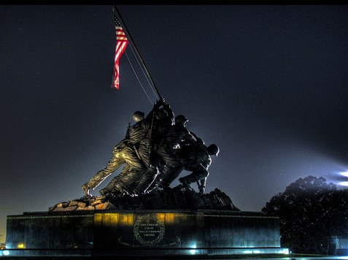

Fleet Logistics Supply Center
Norfolk NDW Postal Division
Mail Clerk/ Orderly Training

Slide 2
FLEET LOGISTICS CENTER JACKSONVILLE
COURSE OVERVIEW
Mail Orderly Appointment
  Designation
  What Can Be Handled
Mail Composition and Make Up
  General Mail Preparation Guide
  Official Mail
  Accountable Mail
  Expedited Services
  International Mail
  Inter-Area Mail
  Official Mail
Responsibilities
  Security
  Accountability

Slide 3
FLEET LOGISTICS CENTER JACKSONVILLE
Designation of Unit Mail Clerks and Mail Orderlies
Prior to entering into mail-handling duties, all
personnel shall receive, at a minimum, training
in:
  The importance of safeguarding mail.
  Handling of accountable mail.
  Timely delivery of mail.
  Consequences for negligence of duty.
3

Slide 4
FLEET LOGISTICS CENTER JACKSONVILLE
Designation of Unit Mail Clerks and Mail Orderlies (cont)
Commanders or designated representatives (Department Heads, Division Officers or Official Mail Managers) shall designate unit mail clerks, or mail orderlies.
Personnel must meet the qualifications in OPNAVINST 5112.6F and DOD Postal Manual 4525.6-M.
Appointment must be in writing utilizing the “Offenses Against The Mail Statement” (OPNAV Form 5112/1) and a DD Form 285 issued…DD Form 2260 will be kept on file in the post office or mail center in lieu of 285.
4

Slide 5
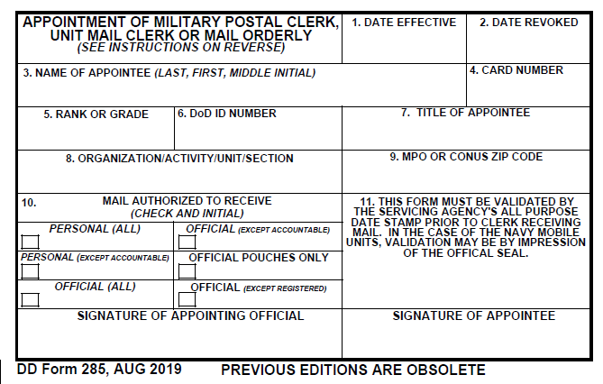
FLEET LOGISTICS CENTER JACKSONVILLE
DD FORM 285 (Appointment of Mail Orderly)
5

Slide 6
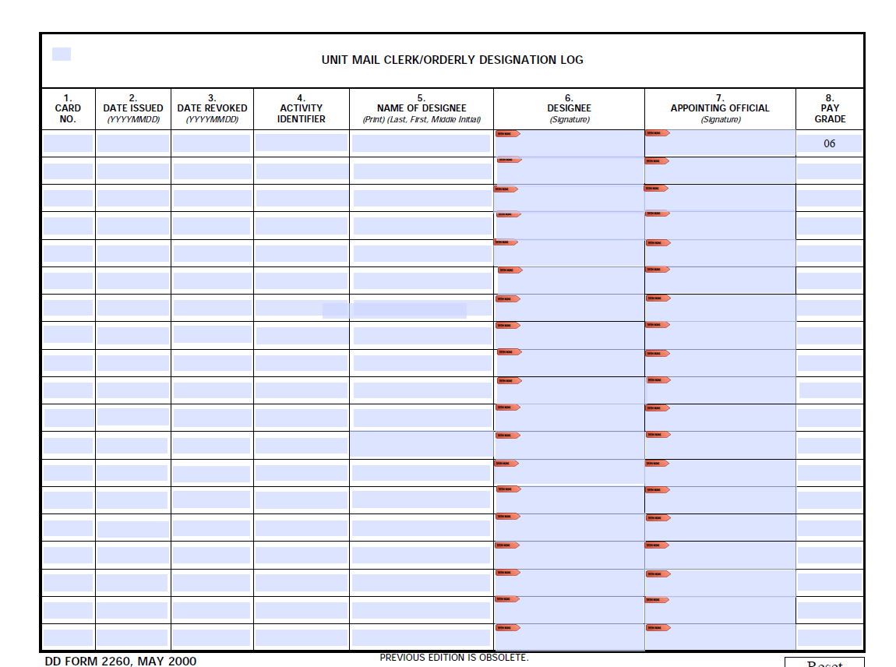
FLEET LOGISTICS CENTER JACKSONVILLE
Mail Orderly Designation Log (DD Form 2260)
6

Slide 7
FLEET LOGISTICS CENTER JACKSONVILLE
Designation of Unit Mail Clerks and Mail Orderlies (cont)
All mail orderlies and unit mail clerks will sign an Offenses Against The Mail Statement (OPNAV Form 5112/1) and this statement must be kept on file in the post office or mail center
Personnel working in a CMF or other official mail center will be designated as mail clerks not Navy Postal Clerks
Personnel receiving mail direct from a Navy Mail Center, Mail Room, Navy Post Office, or direct from a U.S. Postal Service facility will be designated as mail orderlies
7

Slide 8
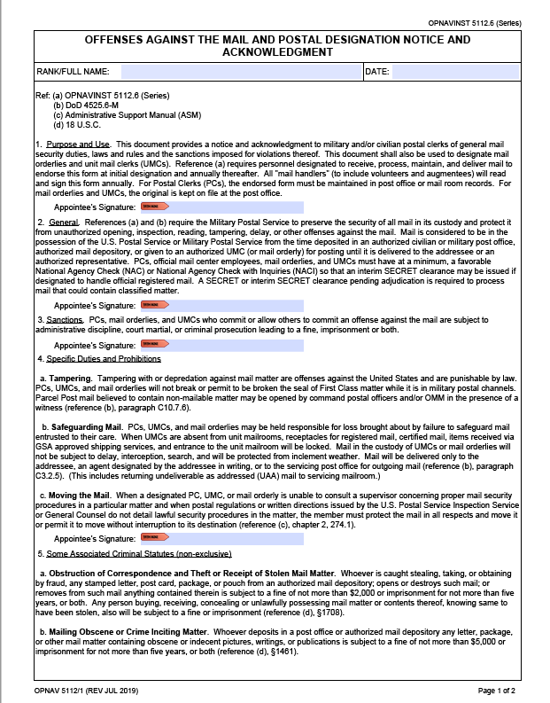
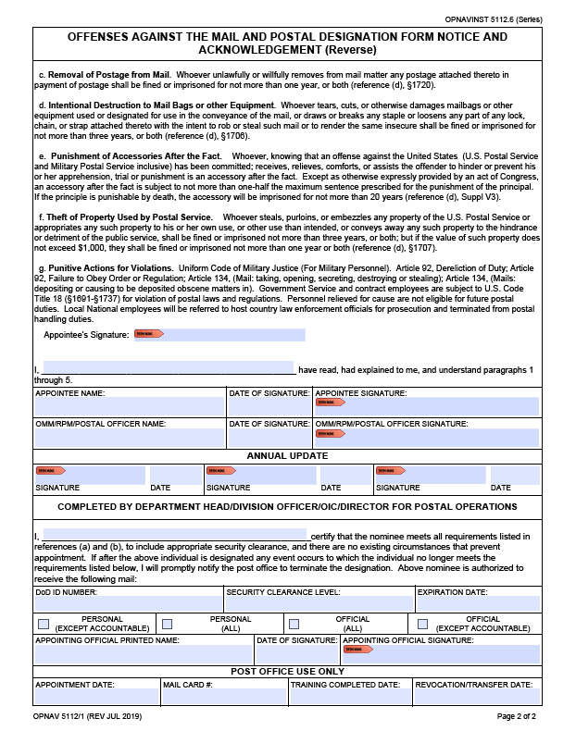
FLEET LOGISTICS CENTER JACKSONVILLE
8

Slide 9
FLEET LOGISTICS CENTER JACKSONVILLE
DD – 285s
Mail Orderlies may be authorized to pick up:
  All Official Mail (Except Accountable)
  All Official Mail (Including Accountable)
Mail Orderlies who are assigned to handle
Official Register Mail:
    Must be eligible for a SECRET security clearance.
9

Slide 10
FLEET LOGISTICS CENTER JACKSONVILLE
MAIL COMPOSITION
AND MAKE UP
10

Slide 11
FLEET LOGISTICS CENTER JACKSONVILLE
Definition
Mail bearing an attention line or the addressee’s name with a job title is considered to be OFFICIAL
Mail bearing an individual’s name but does not have a job
title or the name in the attention line is considered to
be PERSONAL
Use discretion, it is common practice for activities outside of
Department of Defense to address official business matters
to an individual by name, and the address may or may not
include a job title
11

Slide 12
FLEET LOGISTICS CENTER JACKSONVILLE
MAIL PREPARATION AND PACKAGING
Originator’s responsibility
No masking tape
Scotch tape should ONLY be used to reinforce a properly sealed flap on letters or large flat envelopes (should cover the entire flap) DO NOT USE FOR SEALING PARCELS
Distribute weight evenly throughout package
Remove old markings, labels, and barcodes
Use correct size envelopes
All size envelope flaps must be completely sealed (metal tabs & brass clips should be avoided but if used the tab/clip must be covered). Do not use envelopes with string or button closures.
12

Slide 13
FLEET LOGISTICS CENTER JACKSONVILLE
MAIL PREPARATION AND PACKAGING (CONT)
Use letter or flat (manila) envelopes for letters or paperwork only. For rigid, stiff or inflexible items DO NOT place them in regular letter envelopes. For these items please use cardboard or padded type mailers.
Check restrictions for items going to International or FPO/APO addresses before packaging. Contact your local Mail Center for assistance.
13

Slide 14
FLEET LOGISTICS CENTER JACKSONVILLE
ADDRESS PLACEMENT
DEPARTMENT OF THE NAVY
COMMANDING OFFICER
FLCN NAVAL DISTIRCT WASHINGTON
1013 O STREET SE
WASHINGTON NAVY YARD DC 20374-5014
OFFICIAL BUSINESS
Commander
NAVSUP FLCN SAN DIEGO
3985 CUMMINGS ROAD
SAN DIEGO CA 92136-4560
14

Slide 15
FLEET LOGISTICS CENTER JACKSONVILLE
ADDRESS EXAMPLES
RETURN ADDRESS
DEPARTMENT OF THE NAVY
COMMANDING OFFICER
ATTN: SUPPLY OFFICER
HSM-60 UNIT XXXXX BOX XXX
FPO AA 34099
OFFICIAL BUSINESS
‘TO’ ADDRESS
COMMANDING OFFICER
NAVAL HOSPITAL
PSC 812 Box 3560
FPO AE 09627
COMMANDING OFFICER
ATTN MEDICAL DEPT
USS ABRAHAM LINCOLN CVN 72 UNIT # BOX #
FPO AP 96612
Note:
DEPARTMENT OF THE NAVY’ is used for commands within DON.
‘OFFICIAL BUSINESS’ will always be placed below the return address regardless of branch.
Note: The ‘ATTN’ line should always be the second or third line of the address and no information should be placed below the ‘City, State, Zip’ line.
15

Slide 16
FLEET LOGISTICS CENTER JACKSONVILLE
ADDRESSING STANDARDS FOR OFFICIAL MAIL
No handwritten addresses authorized on mail that requires postage
Addresses should be typed
5 line total limit for the ‘To’ address
Minimum punctuation is authorized including the hyphen for a Zip+4
Use the proper 5 digit ZIP Code
Using a generic ‘9999’ or ‘0000’ +4 will result in processing delays to your mail
16

Slide 17
FLEET LOGISTICS CENTER JACKSONVILLE
OFFICIAL MAIL
Remember:
Names in Attention lines mean “Official”
Names with a Title mean “Official”
DO NOT return this mail to the Mail Center as directory mail. If the person whose name appears is no longer at your command, THIS IS STILL YOUR MAIL.
Mobile commands with an FPO will use local addresses while in homeport.
The following slides show the procedures for returning mail that is refused or missent
17

Slide 18
EXAMPLE OF RETURN TO SENDER
FRONT OF MAIL
Customer MUST annotate a circle with the letters “RTS” directly to the left side of address ( It can be noted to the right or above ONLY IF there is no room to the left)
Customer MUST line through address (single line from top left to bottom right of address) and mark out barcodes completely.
RTS
IIIIIiiIIIIIIIiiiiiiIIIIIiiiiIIIIiIII
18

Slide 19
EXAMPLE OF RETURN TO SENDER
BACK OF MAIL
Mail Clerk will make these annotations on the backside. The ONLY time a piece of Official Mail will be RTS’ed is if it is refused. There should be no other reason for returning Official Mail.
Name of command
Date Rcvd____________
Date fwd_____________
Reason______________
Clerk Int/ Card#________
JKB/ 4-22
10 Jul 19
11 Jul 19
Refused
IIIIIiiIIIIIIIiiiiiiIIIIIiiiiIIIIiIII
19

Slide 20
EXAMPLE OF MISSENT
FRONT OF MAIL
Customer MUST circle the address to indicate mail was missent. No other markings are to be made to the front of the mail.
IIIIIiiIIIIIIIiiiiiiIIIIIiiiiIIIIiIII
20

Slide 21
EXAMPLE OF MISSENT
BACK OF MAIL
Mail Clerk will make these annotations on the backside indicating Missent as the Reason. Return to the following Business day to the Official Mail Center
Name of command
Date Rcvd____________
Date fwd_____________
Reason______________
Clerk Int/ Card#________
JKB/ 4-22
10 Jul 19
11 Jul 19
Missent
IIIIIiiIIIIIIIiiiiiiIIIIIiiiiIIIIiIII
21

Slide 22
FLEET LOGISTICS CENTER JACKSONVILLE
REGISTERED
Most secure
Slowest (Require signature each time custody changes)
Expensive
Items that may be sent via REGISTERED MAIL are:
  ANY ‘SECRET’ MATERIAL (Mandatory)
  (Also can be sent via USPS Express Mail or GSA authorized carrier in CONUS)
  NATO CONFIDENTIAL
  ALL CONFIDENTIAL TO FPO / APO ADDRESSES
  EVIDENCE
See DoD 4525.8-M for complete list
22

Slide 23
FLEET LOGISTICS CENTER JACKSONVILLE
REGISTERED MAIL PREPARATION
PS FORM 3877 (Firm Mailing Book) in duplicate
Affix accountable labels at the top of the item between the return address and postage
Cover and firmly seal all open edges of the item (i.e. flaps and seams) with water activated brown paper tape that will absorb an ink impression
No padded envelopes
No cellophane window envelopes
For more info, look in SECNAVINST 5510.36
See FLCN NDW Customer Service Guide for procedures on preparing for shipment
23

Slide 24
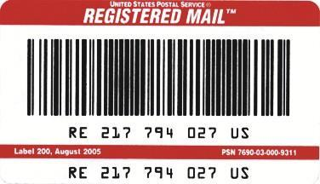
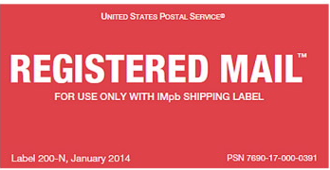
FLEET LOGISTICS CENTER JACKSONVILLE
REGISTERED MAIL LABEL (L200 OR N)
Label 200 or 200-N
Please present your package to a retail employee at a Post Office, station, or branch and the retail associate will affix a USPS Tracking label to the package.
Form 200 is used when your printed postage does not include a tracking barcode.
Form 200-N is used when your postage is printed on a shipping label with a tracking barcode.
24

Slide 25
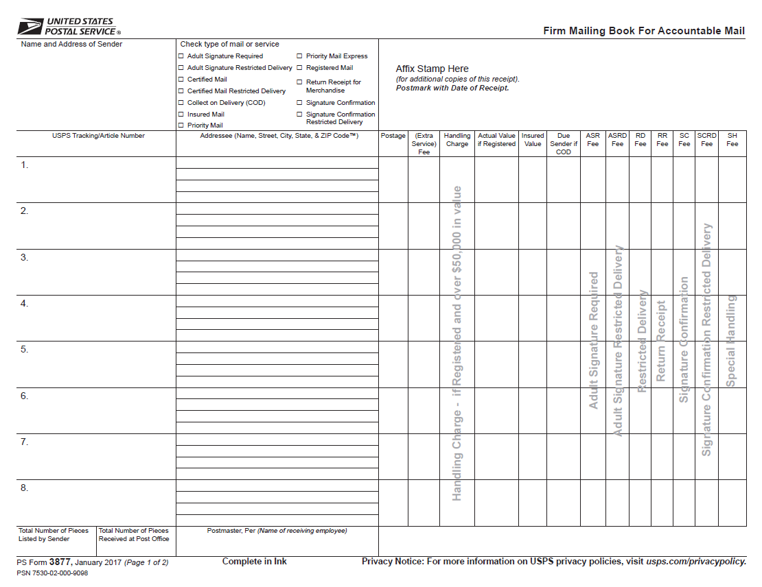
FLEET LOGISTICS CENTER JACKSONVILLE
PS FORM 3877 (Firm Mailing Book)
25

Slide 26
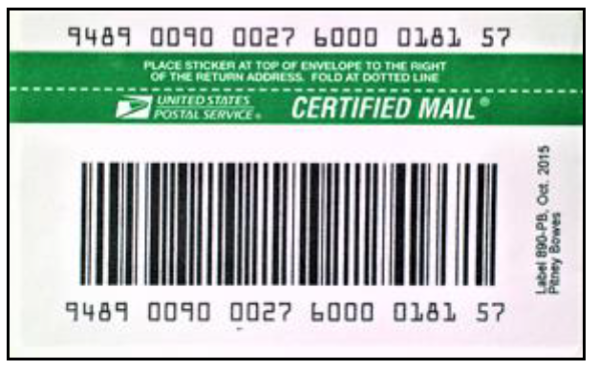
FLEET LOGISTICS CENTER JACKSONVILLE
CERTIFIED MAIL
Available for only USPS First Class and Priority Mail
Provides signature at office of destination
Can be sent to FPO / APO addresses
Items eligible:
EEO material Illegal ID Cards
Court summons Traffic ticket
Dishonored checks
CONFIDENTIAL MATERIAL
(Only to Designated DOD contractors IN-CONUS) *See SECNAVINST 5510.36 for more details
See DoD 4525.8-M for complete list eligible items
26

Slide 27
FLEET LOGISTICS CENTER JACKSONVILLE
CERTIFIED MAIL PREPARATION
Option for mailing individual item:
available for first class mail and Priority only. No insurance coverage is provided.
It is dispatched, handled and treated in transit as ordinary mail. If lost, it cannot be traced or expeditiously recovered.
Use it only within the US domestic and military postal system when law, DOD or directives require it.
27

Slide 28
FLEET LOGISTICS CENTER JACKSONVILLE
CERTIFIED MAIL PREPARATION (CONT.)
USPS Label 3800 will be used for Certified mail at all times except:
  On mail over 3 ounces requiring certified mail service, or ANY certified mailing requiring a return receipt, utilize the NAVSUP FLCN Expedited/ Special services/ Tracking Service Request Form. DO NOT affix label 3800 to item.
The label must be placed above the delivery address and to the right of the return address for envelopes.
See FLCN NDW Customer Service Guide for procedures on preparing for shipment
28

Slide 29
FLEET LOGISTICS CENTER JACKSONVILLE
RETURN RECEIPTS
Only allowed to non-government agencies, civilian firms, corporations, and private individuals when proof of delivery is required by law or regulation
utilize the NAVSUP FLCN Expedited/ Special services/ Tracking Service Request Form to request this service for Certified Mailings. DO NOT affix the Return Receipt to the article.
29

Slide 30
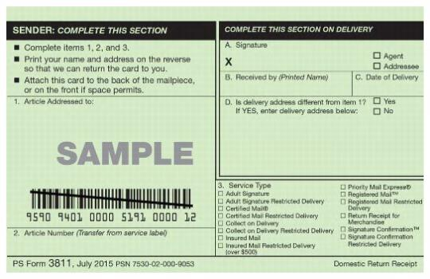
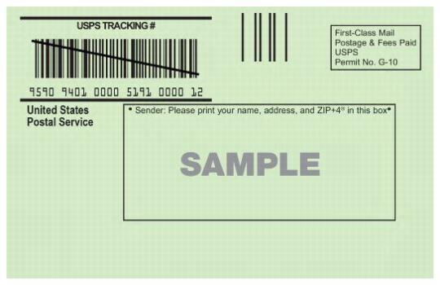
FLEET LOGISTICS CENTER JACKSONVILLE
RETURN RECEIPTS
30

Slide 31
FLEET LOGISTICS CENTER JACKSONVILLE
EXPEDITED SERVICES
Overnight/next day service for extremely time sensitive material is available via FEDEX, UPS or USPS. Use of overnight/next day service is limited to that material which meets one of the following criteria:
Mission failure probable
Significant monetary penalty by Navy will occur
Missing movement/transportation will occur
Extreme adverse effects to operations/personnel
Compelling circumstances in preparation occurred
Request not received in time to meet due date
utilize the NAVSUP FLCN Expedited/ Special services/ Tracking Service Request Form to request this service. DO NOT affix any labels to the shipment.
31

Slide 32
FLEET LOGISTICS CENTER JACKSONVILLE
EXPEDITED SERVICES
USPS EXPRESS MAIL - Authorized in CONUS and authorized FPO / APO
- No CLASSIFIED material can be sent overseas, i.e, FPO/APO…
FEDERAL EXPRESS (FEDEX)
- Cannot be sent to a FPO / APO address
- Can be sent to authorized international address
- Cannot be sent to P.O. Boxes (USPS service)
UNITED PARCEL SERVICE (UPS)
  - Cannot be sent to a FPO/APO address
  - Cannot be sent to P.O. Boxes (USPS service)
32

Slide 33
FLEET LOGISTICS CENTER JACKSONVILLE
EXPEDITED SERVICES (CONT.)
Expedited Mail services shall not be used:
To respond to directed actions or requests for information unless using it is the only way to meet a short suspense. In the event of a short suspense call the one who established the suspense and request an extension.
For the purpose of correcting administrative oversights such as a late suspense when adequate time existed.
On days before weekends or holidays unless the sender has verified someone will be available to accept it and work on it during the weekend or holiday.
Transmitting items within the NCR or within a 75 mile radius (with the exception of death gratuities).
Installation OMMs or their equivalents are authorized to approve the use of overnight services.
33

Slide 34
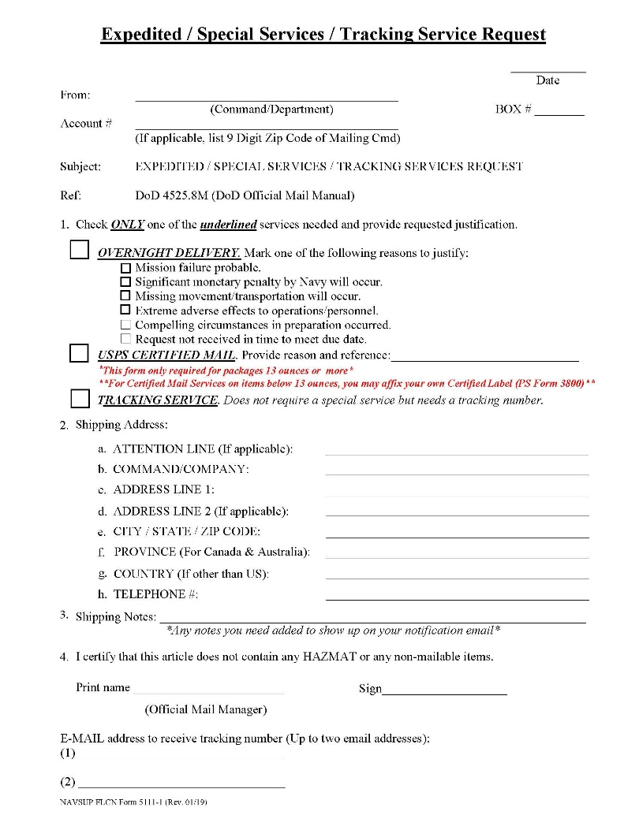
EXPEDITED/TRACKING SERVICE REQUEST

Slide 35
EXPEDITED/TRACKING SERVICE REQUEST
Customers who require Expedited, Tracking or any other Special Service for their shipments must complete the FLCN NDW Form 5111-1, Expedited/ Tracking/ Special Service Request Form.
The form MUST be completed to include at least one valid email address
Once your item is shipped, an email notification will be generated by the shipping system to provide you with the article/ tracking number for your shipment
The only Special Service not required to have this form (at this time) is Registered Mail.

Slide 36
FLEET LOGISTICS CENTER JACKSONVILLE
INTER-AREA MAIL (GUARD MAIL)
DEFINITION: Any official correspondence sent between commands located within the servicing area of Mail Center
Articles are addressed as regular Official Mail
No postage is required
NOT FOR PERSONAL USE
36

Slide 37
FLEET LOGISTICS CENTER JACKSONVILLE
SECURITY OF THE MAIL
All mail must be provided sufficient security to prevent loss, damage, or compromise
Mail should not be left unattended
Mail shall not be delayed
Access to mailrooms should be limited to authorized personnel on official business.
37

Slide 38
FLEET LOGISTICS CENTER JACKSONVILLE
SECURITY OF THE MAIL (Continued)
All PS Forms for accountable mail and DD Forms are kept on hand for a minimum of 2 years to maintain a chain of receipts
Registered Mail, USPS Express Mail, and FedEx must be maintained under tight security until delivered. If retained overnight it must be kept in a GSA approved safe or registered mail cage.
38

Slide 39
FLEET LOGISTICS CENTER JACKSONVILLE
Accountability
As a mail orderly or mail clerk, you are held
liable and accountable for all mail until it is
delivered to the addressee. You can be subject to
administrative discipline, court martial, or
criminal prosecution for offenses against the
mail.
39

Slide 40
FLEET LOGISTICS CENTER JACKSONVILLE
SUMMARY
You should now have the basic fundamental
knowledge to handle your commands
Official and Personal Mail.
As always, contact your serving Mail Center
or Post Office with any questions or concerns.
40

Slide 41
FLEET LOGISTICS CENTER JACKSONVILLE
REFERENCES
DOD OFFICIAL MAIL MANAGEMENT DODI 4525.09
DOD OFFICIAL MAIL MANUAL 4525.8-M
DOD POSTAL MANUAL 4525.6-M
SECNAVINST 5510.36
OPNAVINST 5218.7 series
OPNAVINST 5112.6 series
NAVSUPINST 5112.1
USPS DOMESTIC MAIL MANUAL
USPS INTERNATIONAL MAIL MANUAL
USPS PUB 28 & 221
WWW.USPS.COM
FLCN NDW Postal Customer Service Guide
https://www.navsup.navy.mil/public/navsup/flcn_mail_center/
41

Slide 42


CERTIFICATE OF COMPLETION
THIS CERTIFICATE CERTIFIES THAT
HAS SUCCESSFULLY COMPLETED
The NAVSUP FLCN NDW
Mail Orderly Training
DATE
SIGNATURE
NAVSUP Fleet Logistics Center Norfolk, Naval District Washington

